Slide 1
Eddies: Continuously Adaptive Query Processing
-Ron Avnur and Joseph M. Hellerstein, UC Berkeley
-Presented by aaditya Srinivasan

Slide 2
Outline
Background
Introduction
Reorderability of plans
Rivers and Eddies
Routing Tuples in Eddies
Conclusion and Future Work

Slide 3
Background
System R
Late binding Schemes
Pre-Query Adaptivity
IOR & QS
First Prototype with minimal notion of adaptivity
More adaptive than system R
Makes system R more adaptive
Inter-Operator Re-optimization
Uses batch adaptivity method
Found weak with growing database size, in early 90’s
Introduced Adaptive Selectivity Estimation scheme
Query Scrambling especially for WAN

Slide 4
Background(Contd.)
WHIRL
Adaptive Methods
Rivers
Follows Intra-Operator adaptivity similar to INGRES
Designed at AT&T Labs
Memory adaptive sorting and hashing
Pipelining and Ripple join algorithms
Adaptive Partitioning
Distributed Queue mechanism and Graduated Declustering scheme for data partitioning

Slide 5
Outline
Background
Introduction
Reorderability of plans
Rivers and Eddies
Routing Tuples in Eddies
Conclusion and Future Work

Slide 6
Introduction
Static Query Execution
Hardware and Workload Complexity
Data Complexity
User Interface Complexity
Adaptive Query Processing
A new system, “Telegraph”.

Slide 7
Introduction(Contd.)
Run-Time Variations
Cost of operators
Selectivity of operators
Rates at which tuples arrive from input
Architectural assumptions
Eddy, the query processing operator for Telegraph.

Slide 8
Outline
Background
Introduction
Reorderability of plans
Rivers and Eddies
Routing Tuples in Eddies
Conclusion and Future Work

Slide 9
Reorderability of plans
A challenge before we get to Eddy optimization.
Changing operator order during run-time sounds cool, but is it easy?
Adaptivity precedes best-case scenario in a variable environment.

Slide 10

Reorderability of plans(Contd.)
Synchronization Barrier:
Where one operation hinders the speed of another operation.
Constrains the order in which tuples are consumed.
This is bad news for concurrency.

Slide 11
Reorderability of plans(Contd.)
Extreme Example:
Merge join on two duplicate-free inputs. (slowlow and fasthi)
At run-time the next tuple is always consumed from the relation that had the lowest values
Slowlow is a slowly delivered external relation with many low columns in it’s bandwidth
Fasthi is high bandwidth (i.e. delivers tuples fast) and has only high values in it’s column
In this example fasthi is delayed when slowlow delivers tuples. This is the synchronization barrier.

Slide 12
Reorderability of plans(Contd.)
Moments of Symmetry:
It is when the order of input can be changed without modifying the state in join.
Merge join is a symmetric operator.
How about nested loop joins?

Slide 13
Reorderability of plans(Contd.)
Join Algorithms:
Index Join
Nested Loop Join
Merge Join
Hybrid Hash Join
Ripple Join(Ripples out from the corner of the join)

Slide 14
Reorderability of plans(Contd.)
Join Algorithms:
Better adaptivity compared to other join algorithms.
Adaptive/non-existent barriers.
Frequent moments of symmetry.
Minimal ordering constraints.
So Who is the winner here?
Ripple Join!!

Slide 15
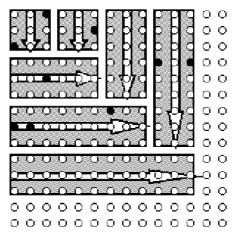
Reorderability of plans(Contd.)
Variations of ripple join:
Block- Obtain data b tuples at a time. For classic ripple join, b=1

Slide 16
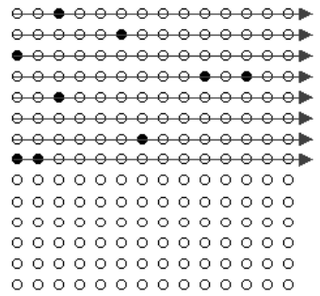
Reorderability of plans(Contd.)
Variations of ripple join:
Index- Identical to indexed-nested loop join.

Slide 17
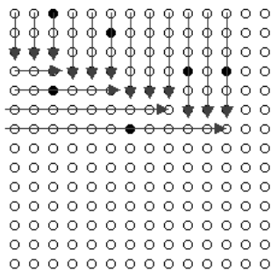
Reorderability of plans(Contd.)
Variations of ripple join:
Hash- Maintains hash tables of samples in memory. Used only for Equijoin queries.

Slide 18
Outline
Background
Introduction
Reorderability of plans
Rivers and Eddies
Routing Tuples in Eddies
Conclusion and Future Work

Slide 19
Rivers & Eddies
River:
River is an adaptive parallel dataflow infrastructure.
River is multi-threaded, with efficient I/O mechanisms.
Pre-Optimization:
Performed by Spanning tree of a query graph.
Specific join algorithms chosen based on the edge being equijoin or non-equijoin.

Slide 20
Rivers & Eddies(Contd.)
An Eddy in the River:
Implemented via a module in the river.
Merges multiple unary and binary into single n-ary operator.
Tuple entering eddy is identified with Ready and Done bits.
Eddies are flexible in the shapes of the trees they can generate.
They are flexible when operators are to be logically reordered.
Eddies are so named because of this circular data flow within a river.

Slide 21
Outline
Background
Introduction
Reorderability of plans
Rivers and Eddies
Routing Tuples in Eddies
Related Work
Conclusion and Future Work

Slide 22
Routing Tuples in Eddies
Eddy module directs the flow of tuples from inputs to output through various operators.
A priority queue is implemented to avoid clogging.
The routing policy determines the efficiency of the system.

Slide 23
Routing Tuples in Eddies(Contd.)
Experimental Setup:
Single-processor Sun Ultra-I workstation
Solaris 2.6 Operating System
160MB RAM
Hash Ripple Join
Index Join with random I/Os within a file.

Slide 24
Routing Tuples in Eddies(Contd.)
So, How to route tuples to different Eddy operators?
Naïve Eddy
Fast Eddy

Slide 25
Routing Tuples in Eddies(Contd.)
Naïve Eddy:
Best suited for handling operators with different costs but equal selectivity.
The query operator with low cost processes its input tuple faster.
Simple fluid dynamics makes naïve eddy effective.
Most tuples are routed to the low cost operator first.

Slide 26
Routing Tuples in Eddies(Contd.)
Fast Eddy:
Naïve eddy was best suited for scenarios with operators of different cost but equal selectivity.
Lottery scheduling is introduced to track both consumption and production over time, by maintaining tickets.

Slide 27
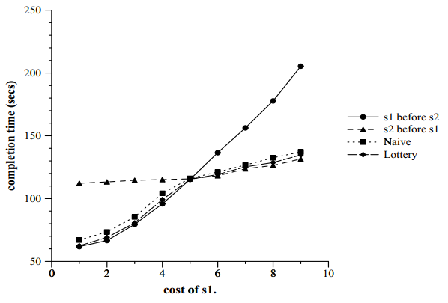
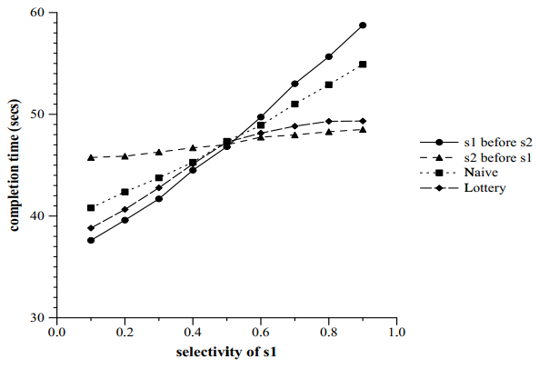
Routing Tuples in Eddies(Contd.)
Experiment results:

Slide 28
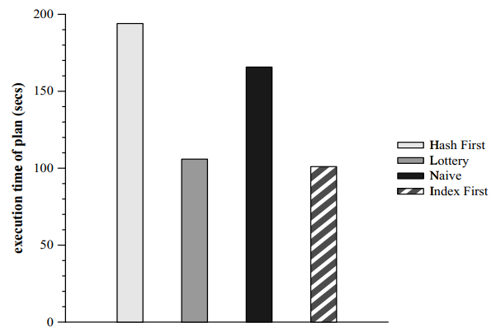
Routing Tuples in Eddies(Contd.)
Performance of Joins:
Hash ripple join between R and S and index join between S and T.
Eddy does well even in static scenarios.
Lottery based eddy performs nearly optimal.

Slide 29
Routing Tuples in Eddies(Contd.)
Responding to Dynamic Fluctuations:
Flaw in the lottery scheme.
How to overcome this problem?
Window Scheme comes to the rescue!!
Time is partitioned into windows in this scheme.

Slide 30

Routing Tuples in Eddies(Contd.)
Responding to Dynamic Fluctuations: (Contd.)
Each operator holds banked tickets and escrow tickets, tracked by Eddy.
Lets Experiment to check this theory.
At the beginning, banked = escrow && escrow=0
3 table equijoin query, with 2 indexes, $I_{fs}$ and $I_{sf}$ experimented with 30,000 tuples.
Indexes swapped after 30 seconds.

Slide 31
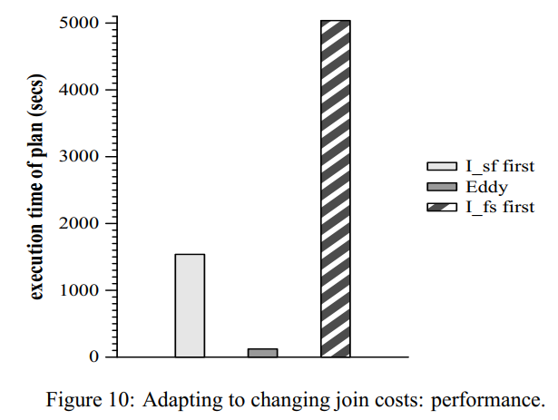

Routing Tuples in Eddies(Contd.)
Responding to Dynamic Fluctuations: (Contd.)
Experiment-1 Results:
Eddy is way faster than both static plans $I_{fs}$ and $I_{sf}.$
Both indexes return a single matching tuple 1% of the time.

Slide 32
Routing Tuples in Eddies(Contd.)
Responding to Dynamic Fluctuations: (Contd.)
Experiment-2 & Results:
Similar to first experiment, but more controlled.
The two indexes return match 10% of the time.
Eddy wins again!!

Slide 33
Routing Tuples in Eddies(Contd.)
Responding to Dynamic Fluctuations: (Contd.)
3rd experiment:
Similar to Exp2 with fixed costs and modified selectivity with time.
Similar results. But changing only the selectivity of the two operators result in less benefits for an adaptive scheme.

Slide 34
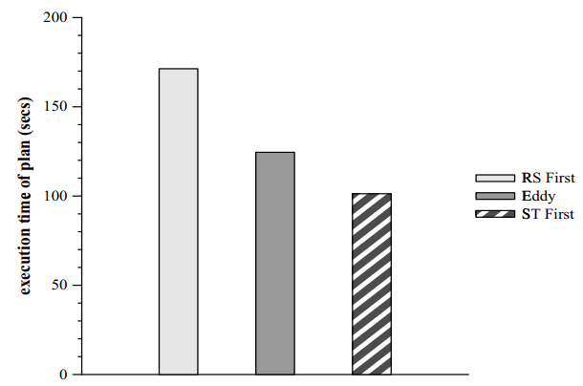
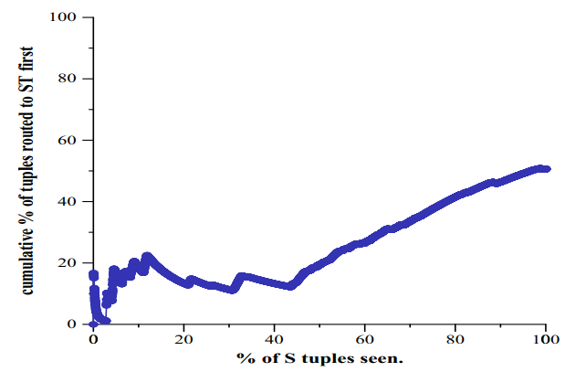
Routing Tuples in Eddies(Contd.)
Delayed Delivery:
Another experiment, to study the effect of initial delay on input relation.
Performance of eddy is not as expected.

Slide 35
Outline
Background
Introduction
Reorderability of plans
Rivers and Eddies
Routing Tuples in Eddies
Conclusion and Future Work

Slide 36
Conclusion and Future work
Eddies are beneficial in unpredictable environments.
It can be used as a sole optimization mechanism.
But Challenges…
Develop eddy “ticket” policy.
Attack remaining static aspects of the schemes.
Harness parallelism and adaptivity available in rivers.
Final goal is to make rivers, a generic parallel dataflow engine, and eddies the main scheduling mechanism.

Slide 37
Thank You!!

Slide 38

Questions???

